Slide 1
FINAL PROJECT
TO-DO LIST

Slide 2
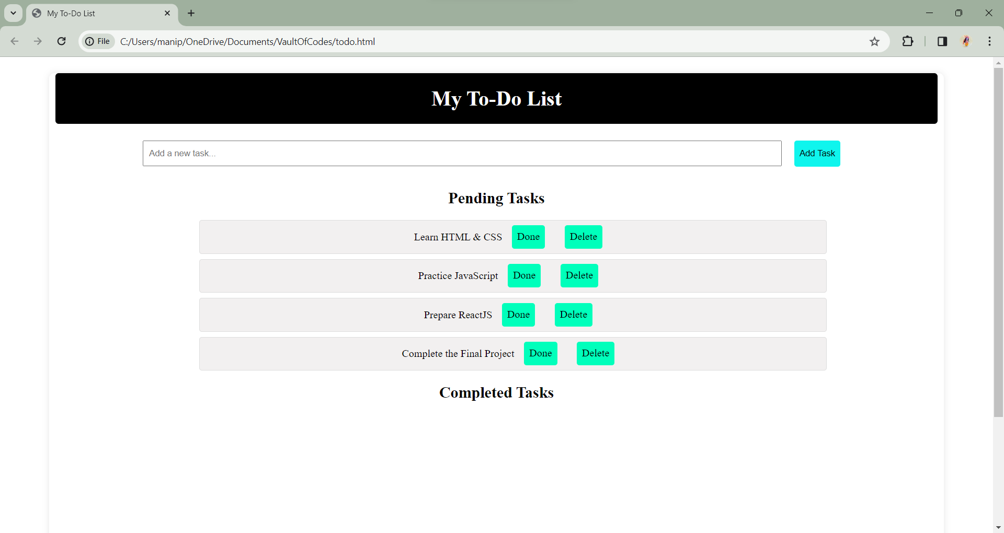
INTRODUCTION
In the fast-paced world of web development, the ability to create dynamic and user-friendly applications is a crucial skill. As part of my internship in web development, I undertook an exciting project aimed at enhancing productivity and organization – the creation of a feature-rich To-Do List web application.

Slide 3
WORKING
The working of a To-Do List website involves several components and functionalities to provide users with an organized and efficient task management system.
Some of them are mentioned below:
Task Categorization and Filtering
Responsive Design
Data Persistence and Security
Intuitive Task Management
Real-time Collaboration

Slide 4
WORKING
The HTML file provides the structure of the web page, including an input field, a button to add tasks, and an unordered list (ul) to display tasks.
The JavaScript file contains a function addTask() that is called when the "Add Task" button is clicked. This function creates a new list item (li) with the task text and a delete button.
The delete button has an onclick event that removes the corresponding task when clicked.
The CSS file provides basic styling to make the To-Do List visually appealing.
This is a straightforward example that demonstrates the core functionality of adding tasks and deleting them. For a more advanced To-Do List application, you might want to consider additional features such as task editing, task completion, and data persistence using local storage or a backend server.

Slide 5
USES
The To-Do List website created above can serve as a practical tool for individuals to organize and manage their tasks effectively. Here are some potential uses of the website:
Personal Task Management: Users can utilize the website to keep track of their daily, weekly, or monthly tasks, helping them stay organized and focused.
Work and Project Planning: Professionals can use the To-Do List to manage work-related tasks and projects, ensuring that important deadlines are met.
Study Planner for Students: Students can organize their study schedule by adding tasks related to assignments, exams, and other academic responsibilities.

Slide 6
USES
Time Management: By categorizing tasks as pending or completed, users can analyze their productivity and time management skills over time.
Goal Tracking: Users can set goals and break them down into actionable tasks. The To-Do List helps in monitoring progress and achieving objectives.
Daily Reminders: The website can be used as a digital reminder system. Users can quickly add tasks and set priorities, ensuring that nothing important is overlooked.
Learning JavaScript and Web Development: As a simple web development project, this website can be a valuable learning tool for individuals looking to improve their skills in HTML, CSS, and JavaScript.

Slide 7
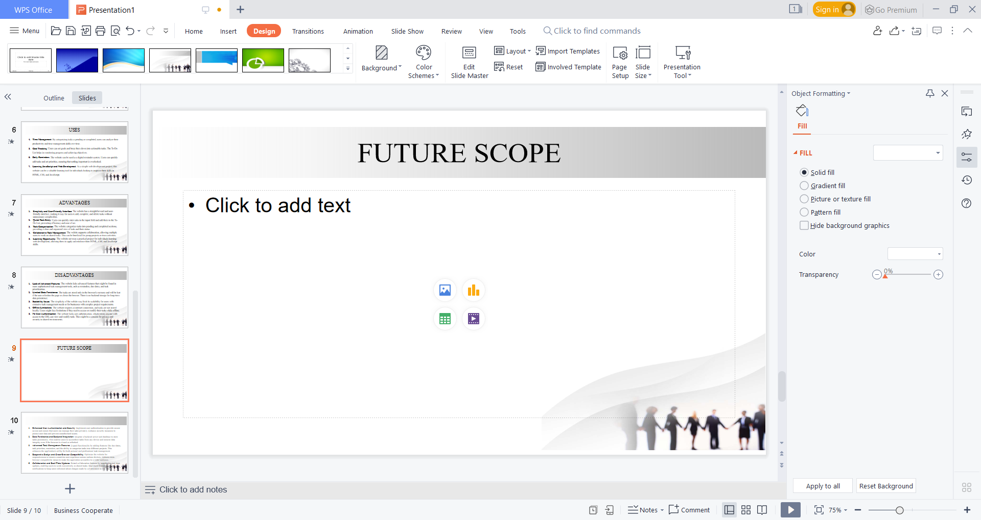
ADVANTAGES
Simplicity and User-Friendly Interface: The website has a straightforward and user-friendly interface, making it easy for users to add, complete, and delete tasks without unnecessary complexities.
Quick Task Entry: Users can quickly enter tasks in the input field and add them to the To-Do List, promoting efficiency and ease of use.
Task Categorization: The website categorizes tasks into pending and completed sections, providing a clear and organized view of tasks and their status.
Collaborative Task Management: The website supports collaboration, allowing multiple users to work on shared tasks. This can be beneficial for group projects or team activities.
Learning Opportunity: The website serves as a practical project for individuals learning web development, allowing them to apply and reinforce their HTML, CSS, and JavaScript skills.

Slide 8
DISADVANTAGES
Lack of Advanced Features: The website lacks advanced features that might be found in more sophisticated task management tools, such as reminders, due dates, and task prioritization.
Limited Data Persistence: The tasks are stored only in the browser's memory and will be lost if the user refreshes the page or closes the browser. There is no backend storage for long-term data persistence.
Scalability Issues: The simplicity of the website may limit its scalability for users with extensive task management needs or for businesses with complex project requirements.
Offline Limitations: The website requires an internet connection, and tasks are not stored locally. Users might face limitations if they need to access or modify their tasks while offline.
No User Authentication: The website lacks user authentication, which means anyone with access to the URL can view and modify tasks. This might be a concern for privacy and security in shared environments.

Slide 9
FUTURE SCOPE
Enhanced User Authentication and Security: Implement user authentication to provide secure access and ensure that users can manage their tasks privately. Enhance security measures to protect user data and prevent unauthorized access.
Data Persistence and Backend Integration: Integrate a backend server and database to store tasks persistently. This enables users to access their tasks from any device and ensures data integrity even if the browser is closed or refreshed.
Advanced Task Management Features: Expand functionality by adding features like due dates, task priorities, reminders, and the ability to categorize tasks into different projects. This enhances the application's utility for both personal and professional task management.
Responsive Design and Cross-Browser Compatibility: Optimize the website for responsiveness to ensure a seamless user experience across various devices. Address cross-browser compatibility issues to make the application accessible to a wider audience.

Slide 10
OUTPUT
To-Do List Web Page: The page will display a heading "To-Do List" along with an input field to add new tasks, an "Add Task" button, and an empty unordered list (ul) to display tasks.
Adding Tasks: Enter a task in the input field and click the "Add Task" button. The entered task will appear as a list item (li) with a delete button to the right.
Deleting Tasks: Each task will have a "Delete" button. Clicking the "Delete" button will remove the corresponding task from the list.
Styling: The page has basic styling to make it visually appealing, with a centered layout, a white background for the To-Do List container, and a red-colored delete button.

Slide 11
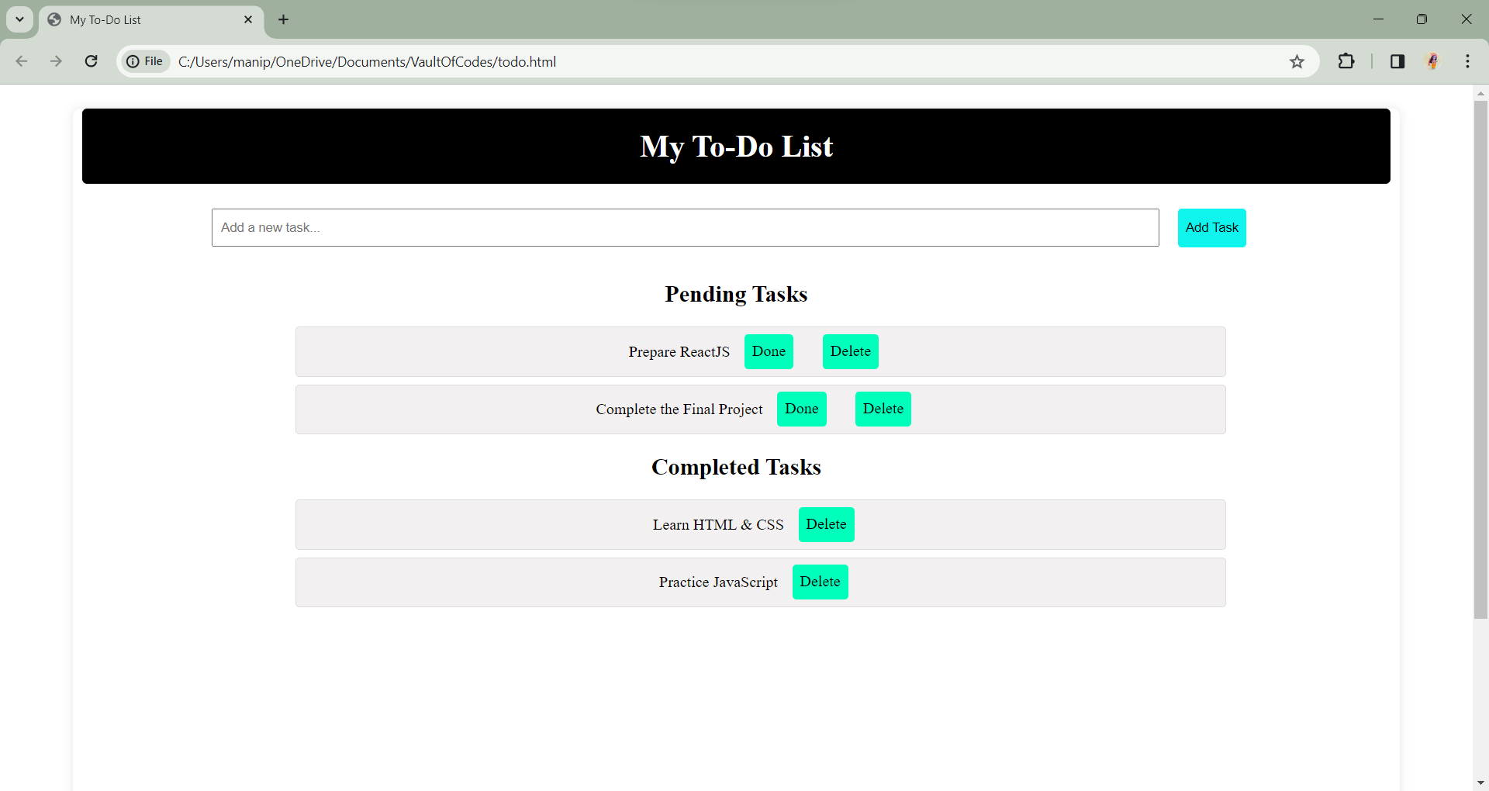
OUTPUT

Slide 12


